Slide 1
Baseball
By Shawn Smith and Christian Winwood

Slide 2
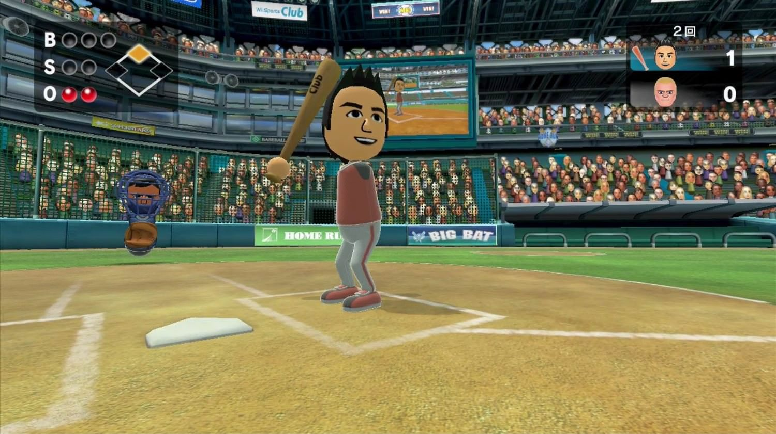
Idea
Wii Sports Baseball game.
You can attempt to hit the ball and then depending on where the ball lands determines the result of the play.
We turned this concept into a multi processor, console based, 0 interaction “game”.

Slide 3
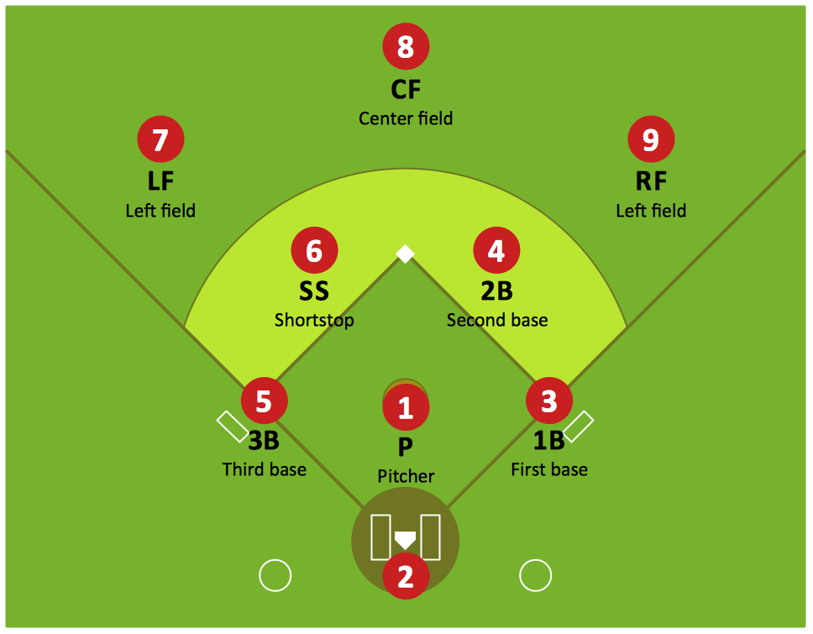
Design
Each process represent a player on the field.
The 0 process, or root, is the pitcher and manages every aspect of the game.
Processor 1, represents the batter
Every other process represents a different position on the field.

Slide 4
Game Flow
The pitcher randomly chooses a pitch.
Each pitch has a different difficulty to hit.
The pitch is then sent to the batter who generates a random number representing the swing.
After checking that the swing is above a certain number for each pitch, we can generate a hit.
The ball is then sent to a random processor with a difficulty modifier applied. The fielder than determines whether they make the out, or the batter gets a single or a double.
The information is then sent back to the pitcher to continue the game.

Slide 5
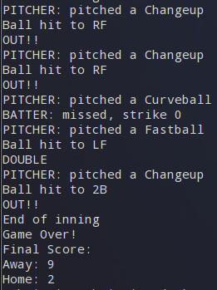
Output
Only root process prints
Prints in order
Easy to read through the game

Slide 6
Scoring
9 Innings
Score when player reaches home
Each team gets 9 tries to bat
Root process manages score

Slide 7
Questions?

